Slide 1
Intruder Aircraft Detection
Tom Evans

Slide 2
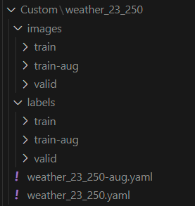

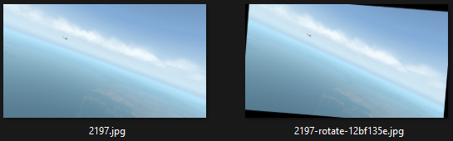

Dataset Manipulation
Dataset Samples mirrored AVODDS and YOLO format
Augmented Image and Label given unique filename based on original Image
Augmented Dataset Directory
Original Bounding Box Co-ordinates
Augmented Bounding Box Co-ordinates
Augmented Dataset Directory

Slide 3
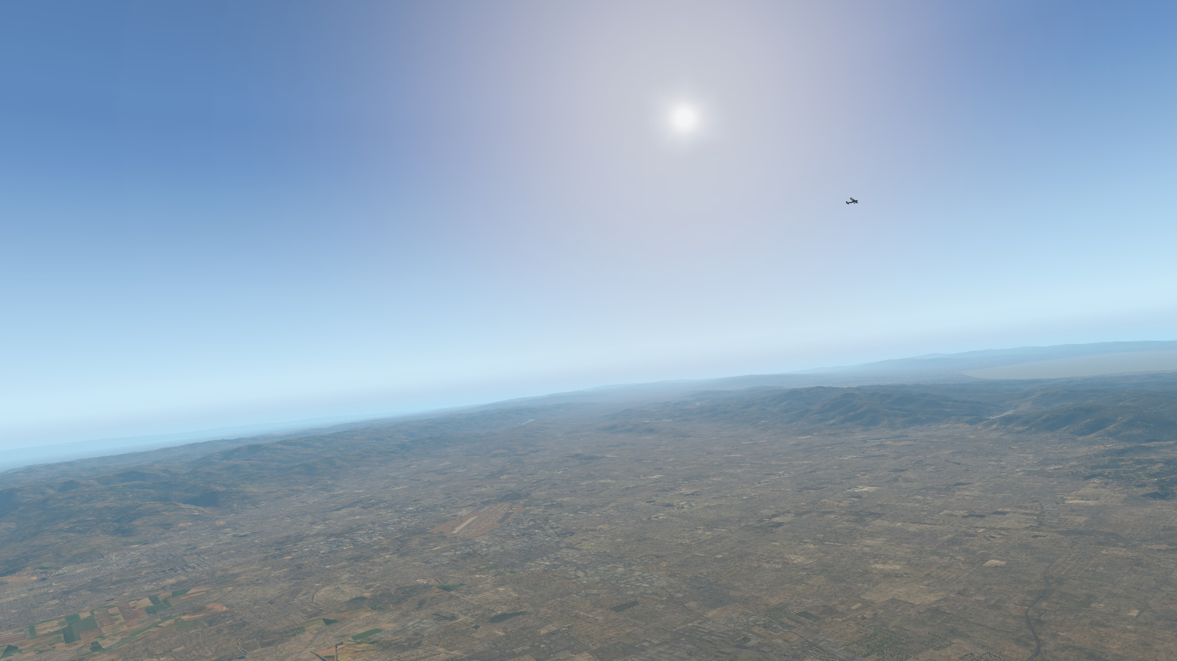
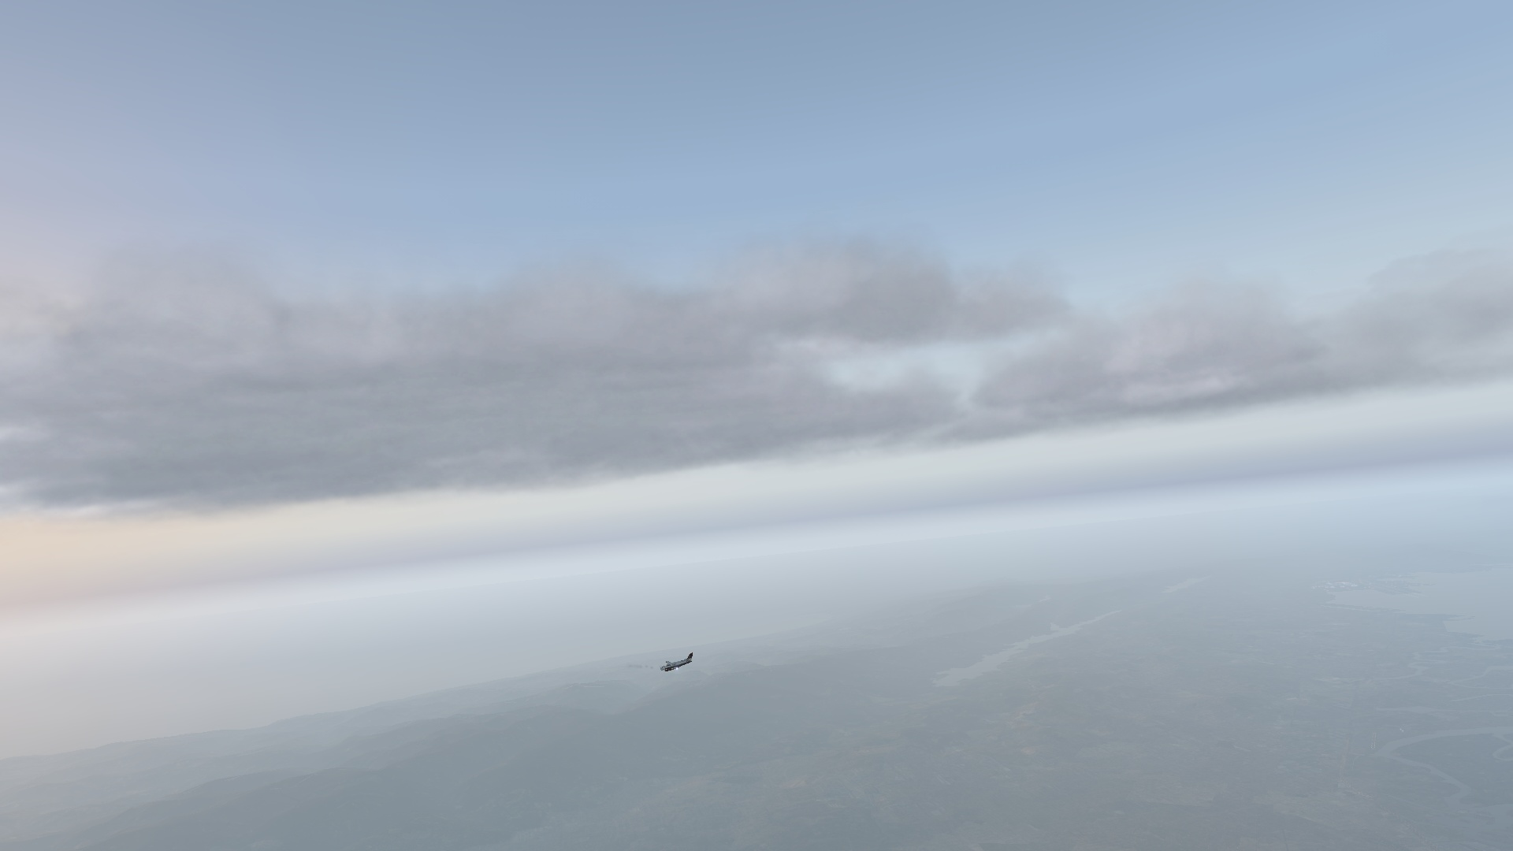
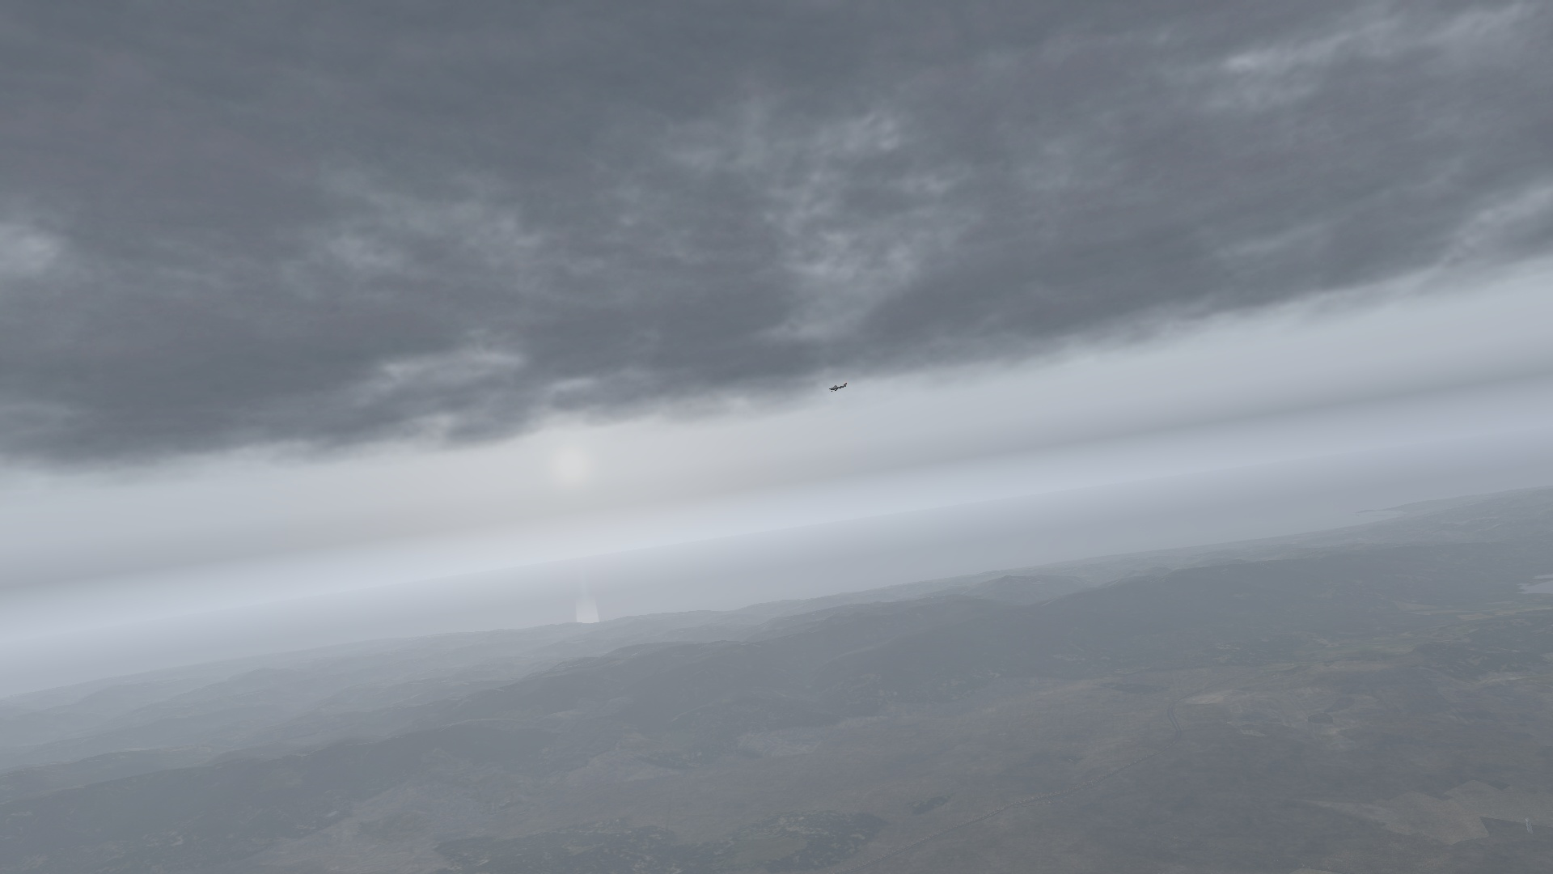
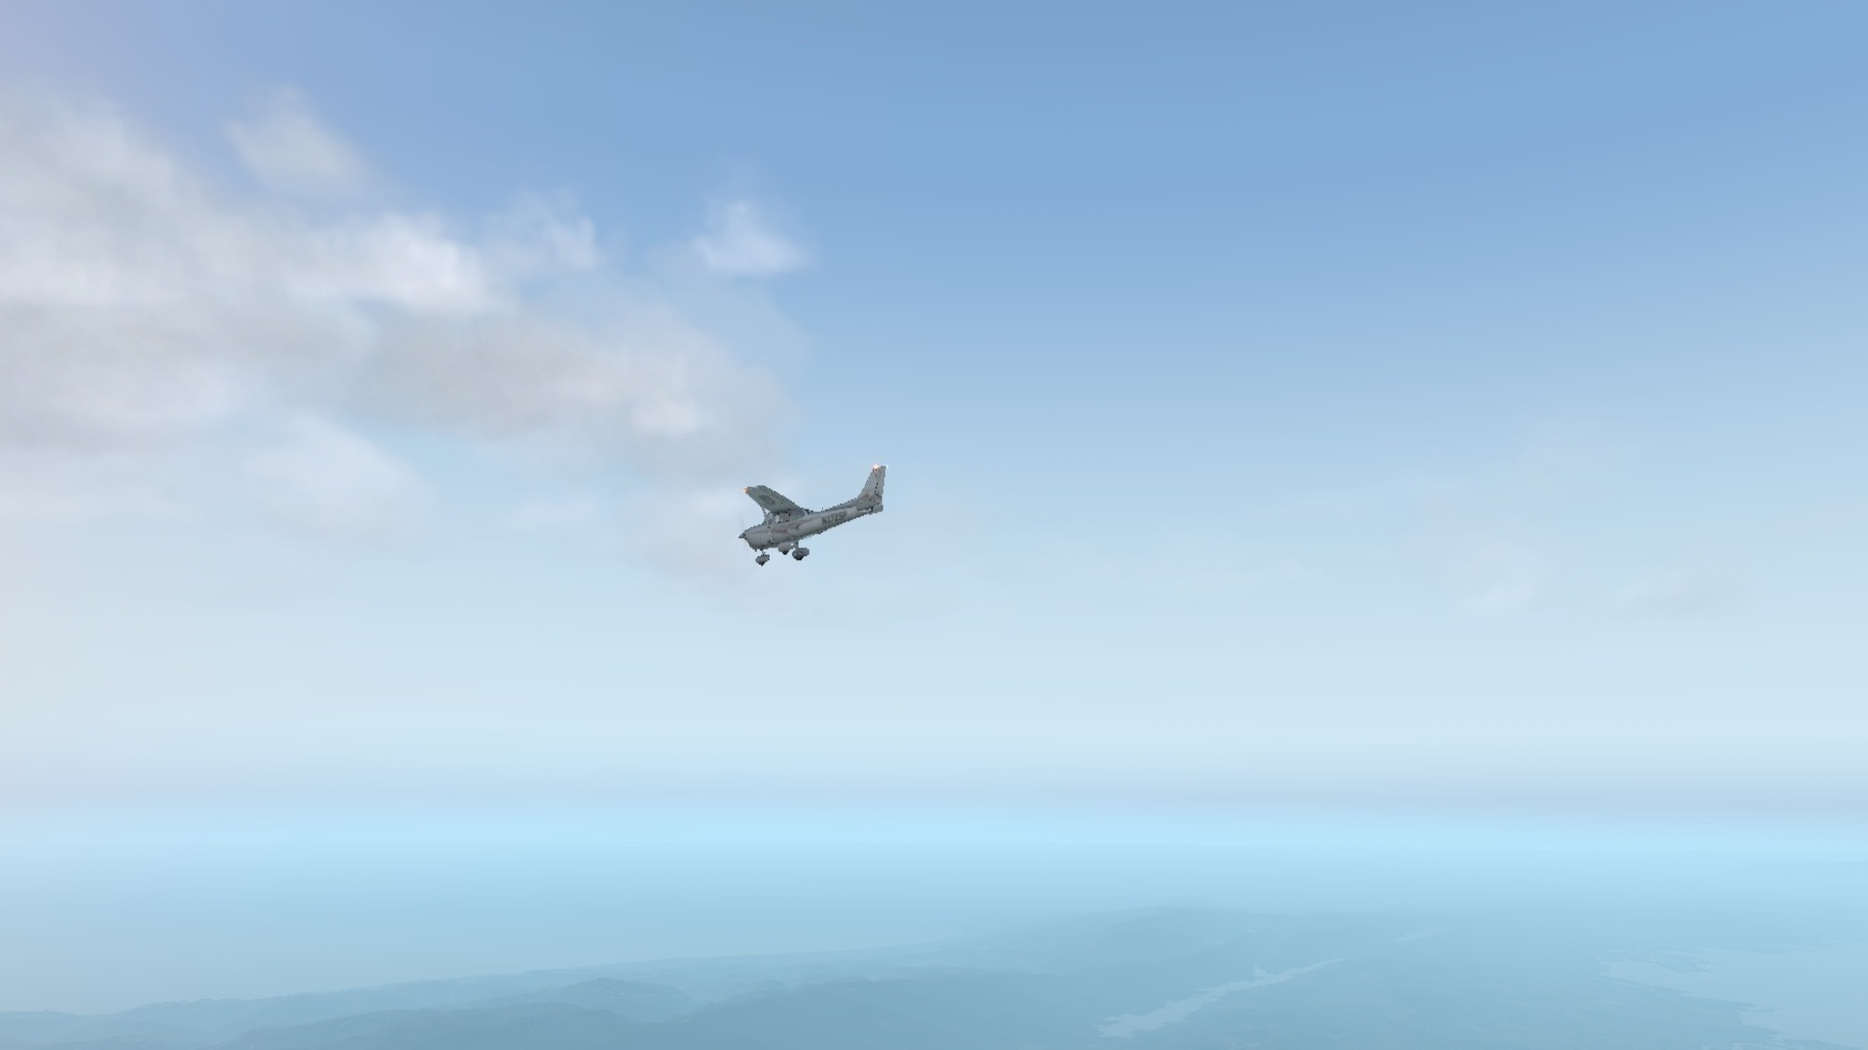
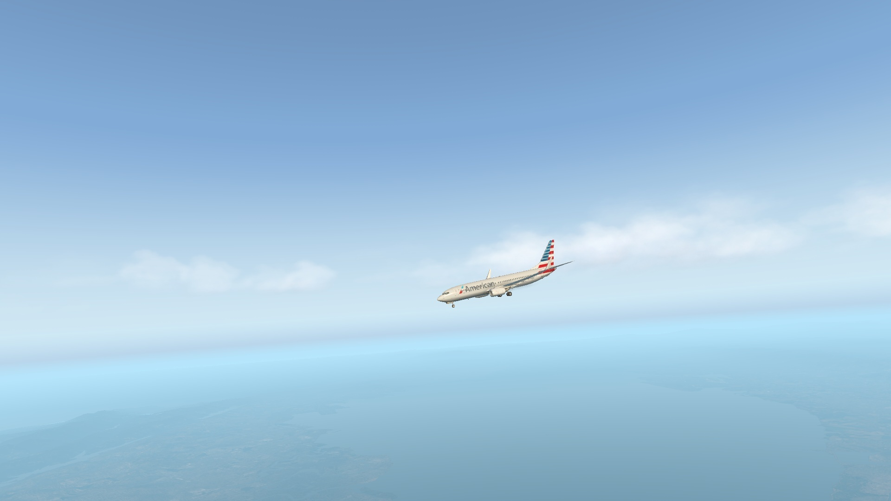
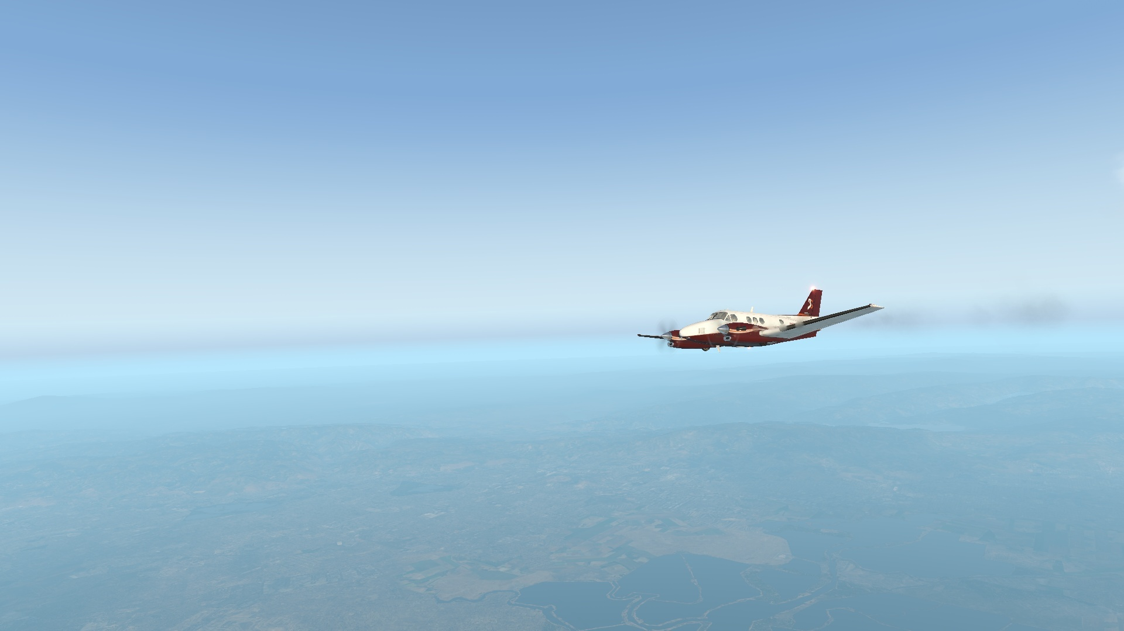
Dataset Manipulation
Dataset samples are stratified by Aircraft and Weather Conditions
Unable to stratify by time of day due to AVOIDDS metadata
Clear Conditions
Cloudy Conditions
Disruptive Conditions
Cessna Skyhawk
Boeing 737-800
King Air C90

Slide 4
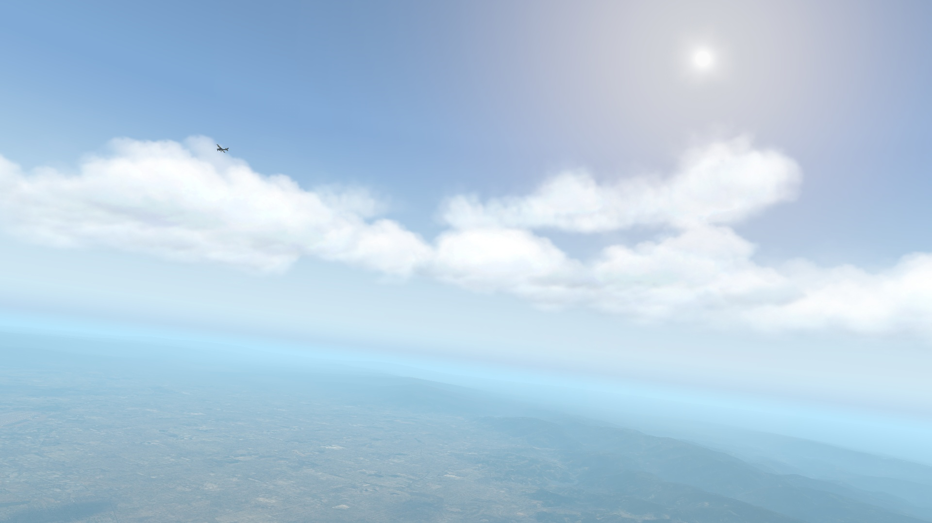
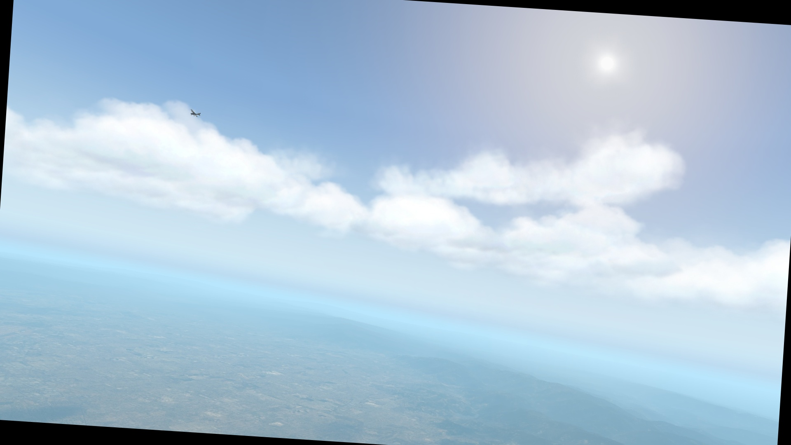
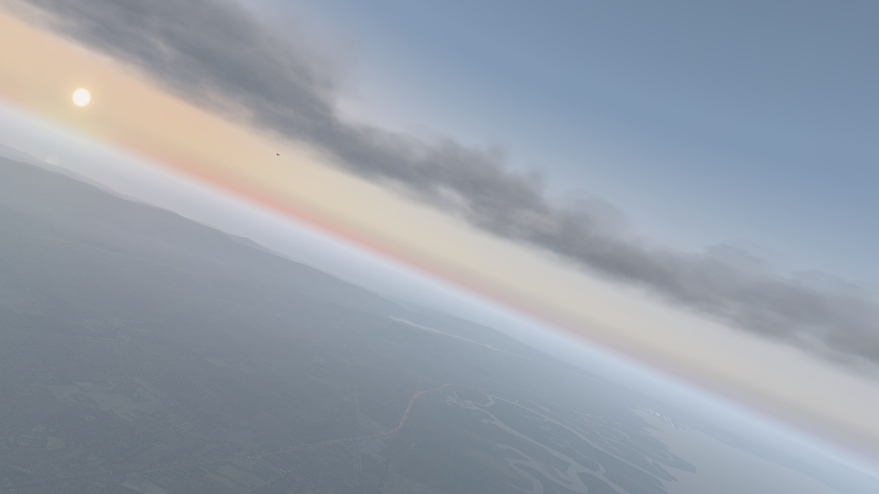
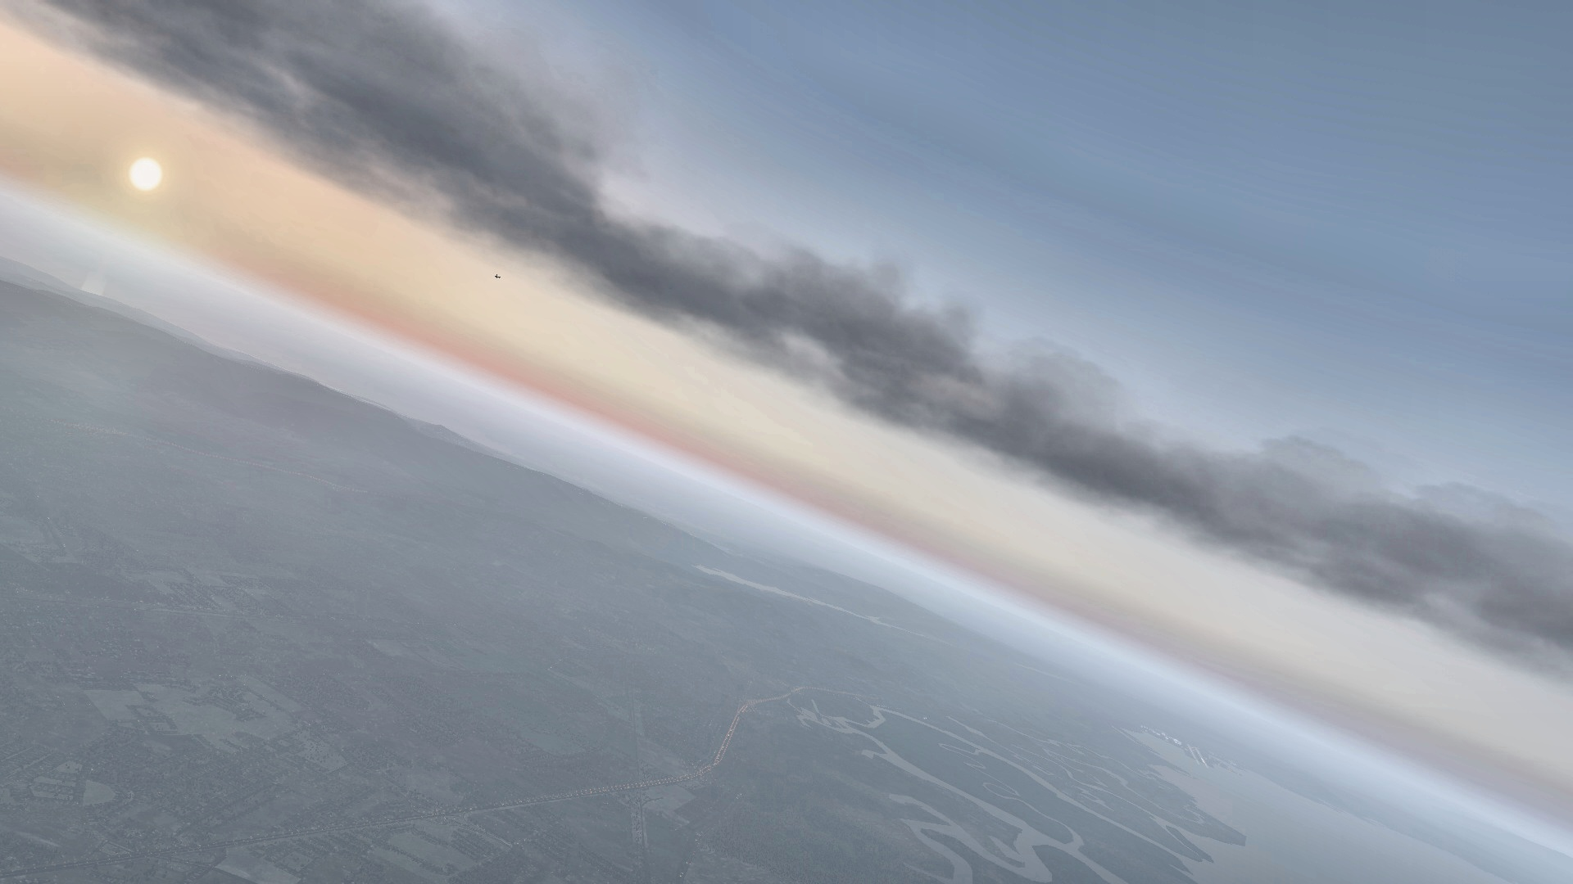
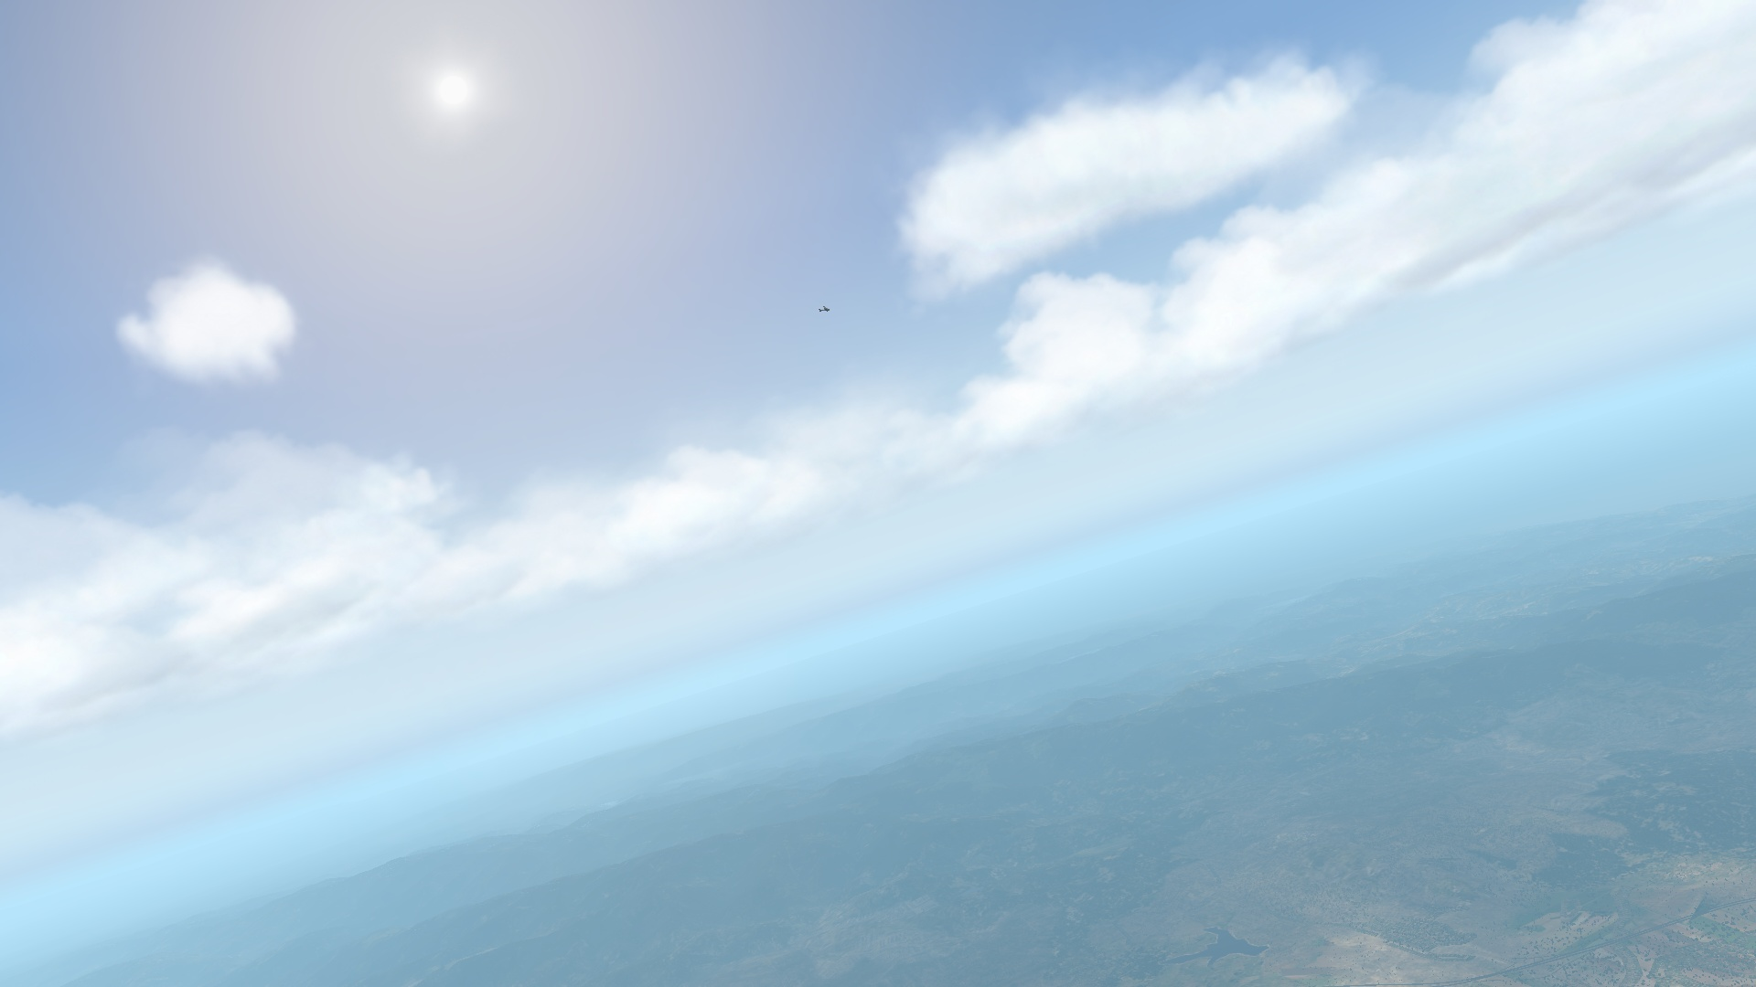
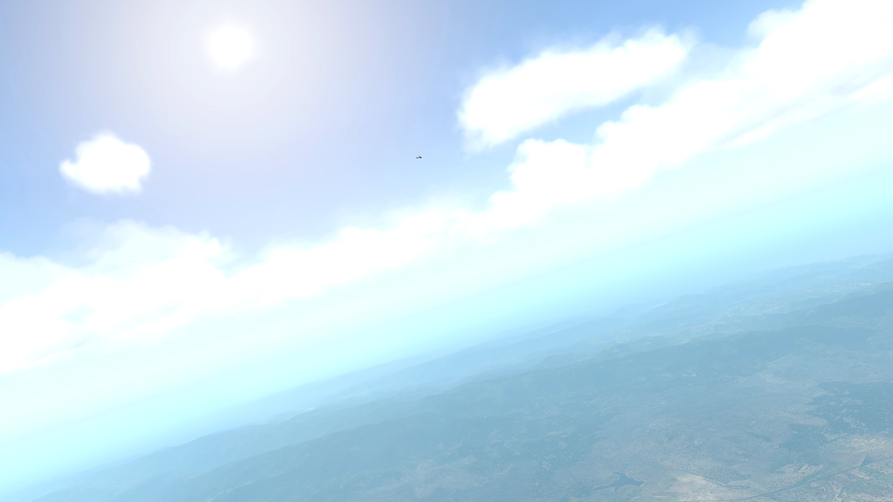
Augmentation Examples
Rotate
Histogram Equalisation
Contrast
Minor image modifications outperformed more drastic transformations

Slide 5
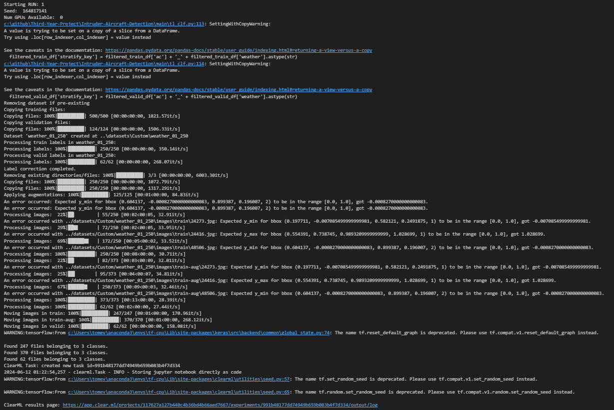
Training with Keras
Executes dataset manipulation pipeline, including zoom preprocessing
Small percentage of images fail augmentation
Error is caught and image is removed from dataset
Creates ClearML task
Console output from dataset manipulation stage of experiment execution

Slide 6
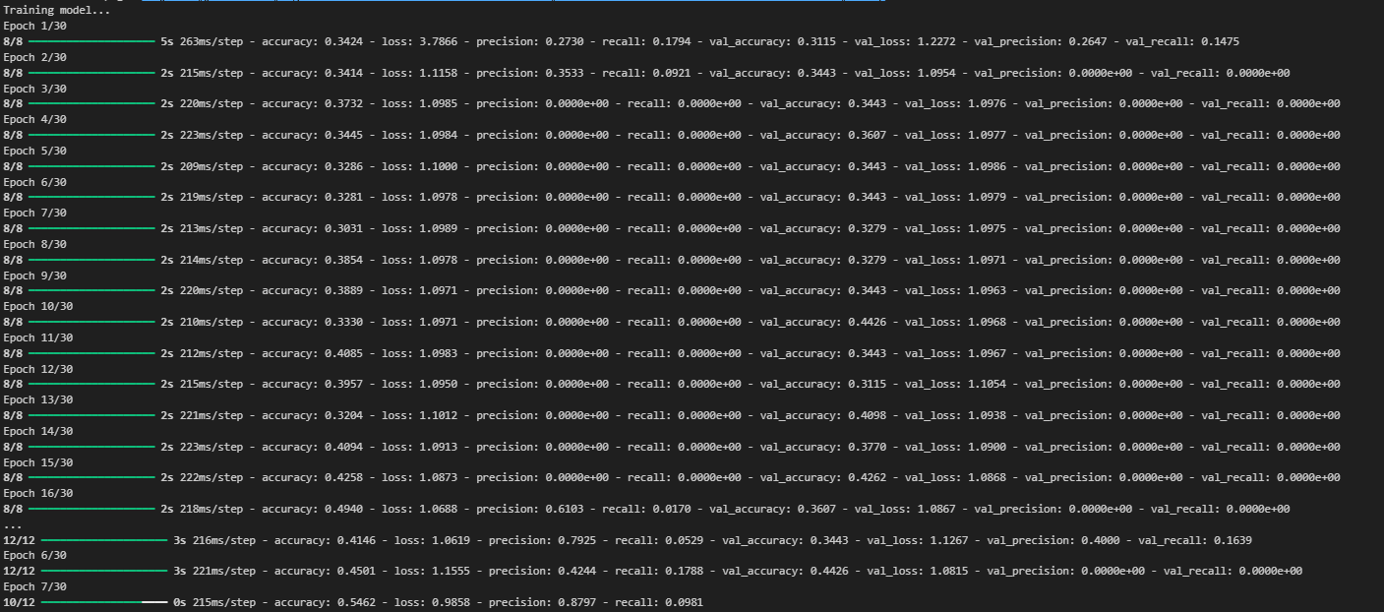
Training with Keras
Trains Keras Model with Pure set followed by Augmented
Predicts on Validation
Logs Metrics to ClearML
Console output from training stage of experiment execution

Slide 7
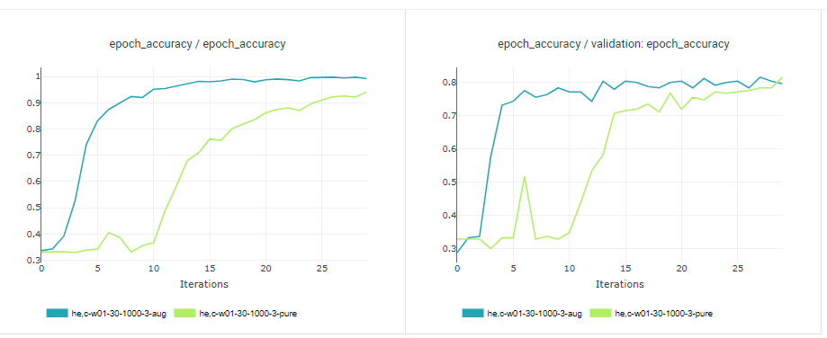
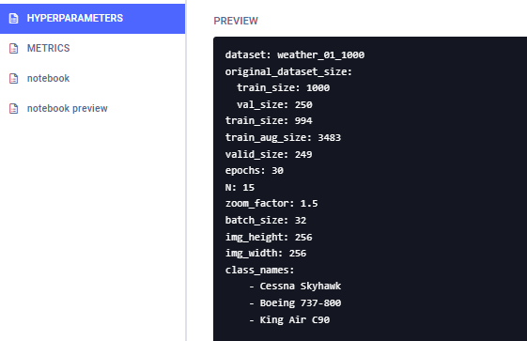
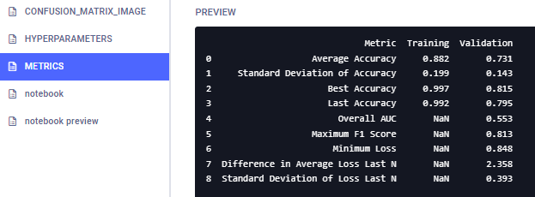
Training with Keras
Compare Validation Accuracy vs Epoch Graphs with ClearML
Augmented run converged at earlier epoch with steeper gradient at learning phase
Store Metrics and hyperparameters as ClearML artefacts
Augmented Run converged at earlier epoch and learnt with st
Metrics Dictionary Artefact
Hyperparameters Dictionary Artefact

Slide 8
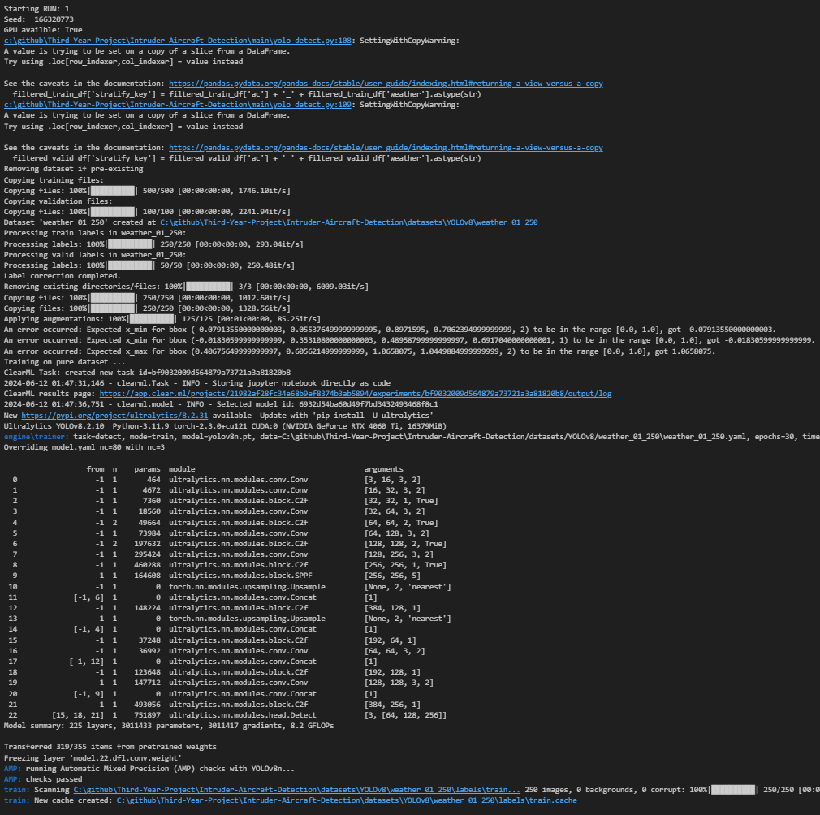
Training with YOLO
Dataset pipeline excludes zoom pre-processing
YOLO does not work with relative paths
Creates ClearML task and loads YOLO model
Console output from dataset manipulation stage of YOLO experiment execution

Slide 9
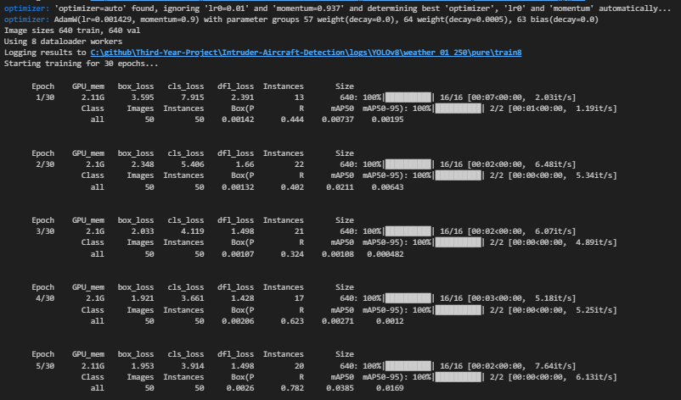
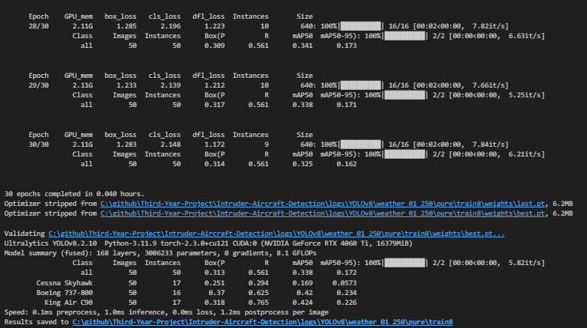
Training with YOLO
YOLO metrics are automatically calculated
Other than macro average F1 score
Console output from stage of YOLO experiment execution

Slide 10
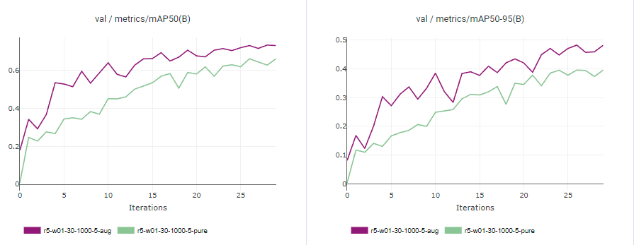
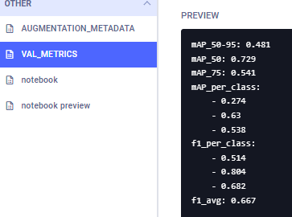
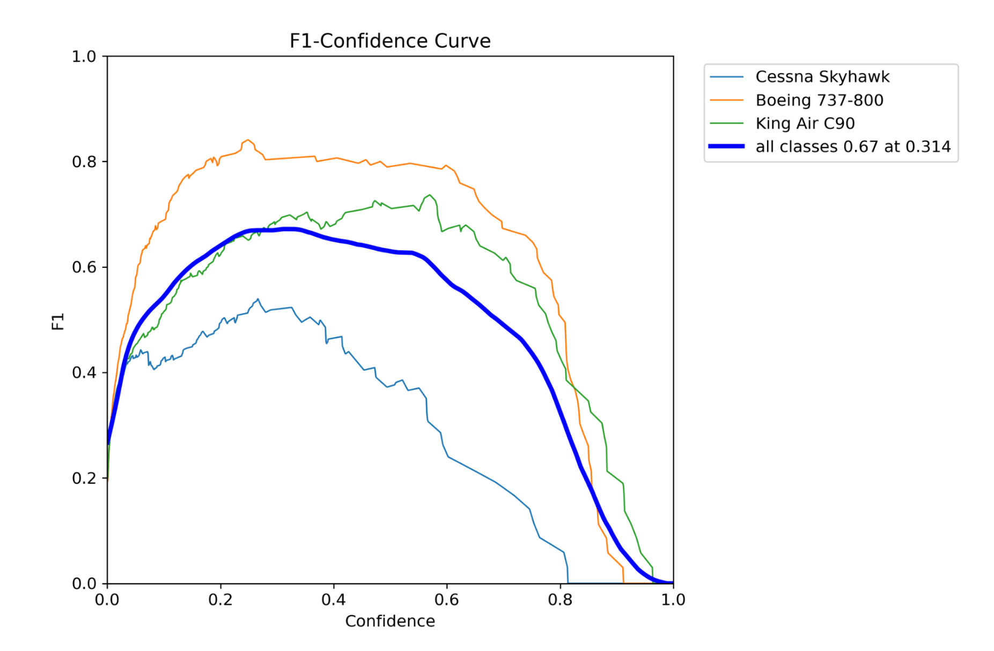
Training with YOLO
Metrics logged with ClearML
Plots generated with both YOLO and ClearML
Validation Plots for mAP50 and mAP50-95 – ClearML plot
YOLO Metrics Dictionary
Example F1 plot generated by YOLO

Slide 11
Total number of Experiments
Total number of individual ClearML tasks, not including prototyping or debugging
Image Classifications with Keras: 1926
Object Detection with YOLO: 270

Slide 12
Future Work
Use external computation services like Lyceum or Microsoft Azure
Expand Augmentation methods. For example: HSV shifts (background image!)
Expand beyond image utilising YOLO real-time object detection.

